Slide 1
XSS
(CROSS SITE SCRIPTING)
PRESENTED BY:
SRITAMA RAY 21103014 B1
RAHUL ANAND 21103033 B2
ASTHA RAGHUWANSHI 21103042 B2
JAHANVI GUPTA 21103150 B6

Slide 2
INDEX
Introduction
What is SOP
What is Cross-site Scripting
Different types of Cross-Site Scripting
Impact of Cross-Site Scripting
Ways to identify XSS vulnerabilities
Preventing Cross-Site Scripting attacks

Slide 3
INTRODUCTION
In today’s world when websites and web applications have become an integral part of our professional and personal life, It is important to keep our data and integrity safe from attacks and injections which happen through the web. We have chosen Cross Site Scripting(XSS) as our topic because it is a widespread vulnerability which can be found in any website if not taken complete precautions. This vulnerability is also featured in the OWASP top 10 vulnerabilities list.

Slide 4
WHAT IS SOP
Same Origin Policy (SOP)Definition: SOP is a security measure implemented by web browsers to prevent web pages from making requests to a different domain than the one that served the original web page.Three Key Rules Same Protocol: The protocol (e.g., HTTP or HTTPS) of both the originating and target page must be the same .Same Host: The host (domain) of both the originating and target page must be the same.Same Port: The port number of both the originating and target page must be the same.Same Origin Context: The injected script operates in the context of the user's session, bypassing SOP restrictions.

Slide 5
WHAT IS XSS
Cross site scripting (XSS) is a common attack vector that injects malicious code into a vulnerable web application.
XSS differs from other web attack vectors (e.g., SQL injections), in that it does not directly target the application itself. Instead, the users of the web application are the ones at risk.
A successful cross site scripting attack can have devastating consequences for an online business’s reputation and its relationship with its clients.

Slide 6
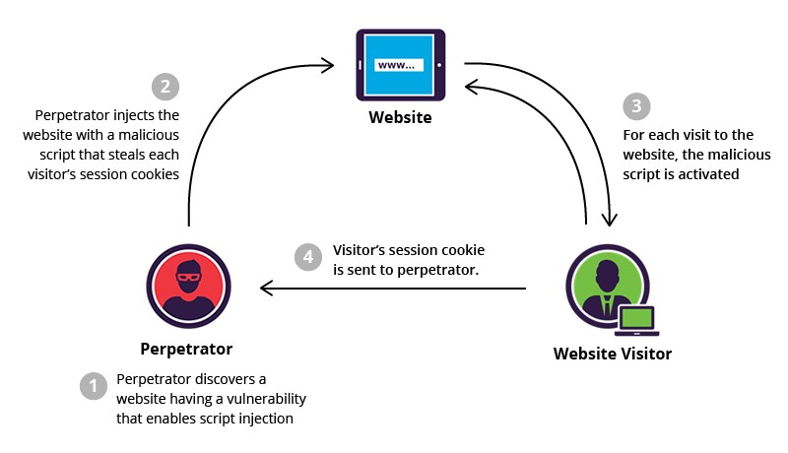
WHAT IS XSS?

Slide 7
TYPES OF XSS
There are mainly three different types of Cross-site Scripting vulnerability;
Reflected XSS
A reflected XSS vulnerability happens when the user input from a URL or
POST data is reflected on the page without being stored.
Persistent or Stored XSS
Stored Cross-site scripting vulnerabilities happens when the payload is saved,
for example in a database and then is executed when a user opens the page. Stored cross-site scripting is very dangerous for a number of reasons
DOM-based XSS
The DOM Based XSS vulnerability happens in the DOM (Document Object Model) instead of part of the HTML.

Slide 8
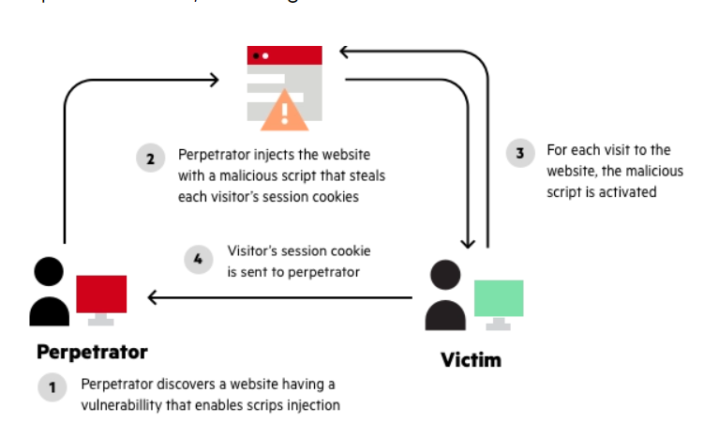
REFLECTED XSS

Slide 9
REFLECTED XSS
Reflected XSS (Cross-Site Scripting) is a web security vulnerability where an attacker injects malicious scripts into a web application's user inputs. These scripts are then immediately reflected back to the user by the web server, typically through URL parameters or input fields. The malicious payload is executed in the victim's browser, potentially allowing the attacker to steal sensitive information or perform unauthorized actions within the user's session. Mitigation strategies include input validation, output encoding, Content Security Policy (CSP), and developer education on secure coding practices.

Slide 10
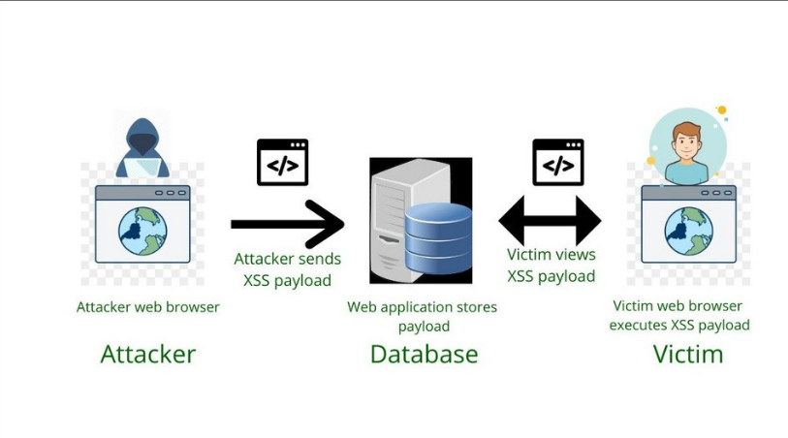
STORED XSS

Slide 11
STORED XSS
Stored XSS (Cross-Site Scripting) is a web security vulnerability where an attacker injects malicious scripts into a web application, and these scripts are permanently stored on the server. The injected payload is then served to users whenever they access the affected page, leading to the execution of the malicious script in their browsers. Attackers exploit this vulnerability to perform actions within the context of the user's session, such as stealing sensitive information. Mitigation strategies include input validation, output encoding, Content Security Policy (CSP), and regular security audits.

Slide 12
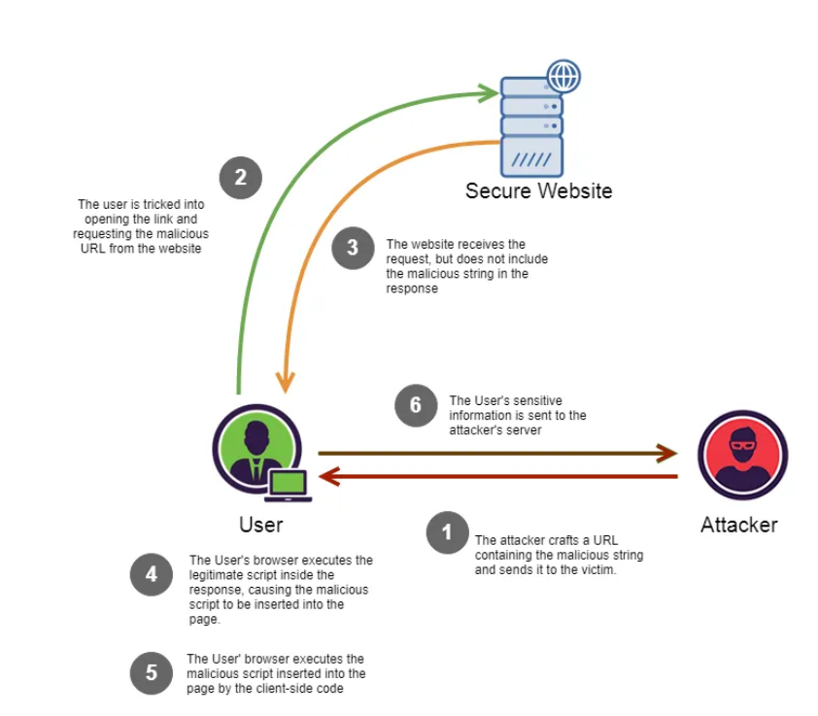
DOM BASED

Slide 13
DOM BASED XSS
DOM Based XSS (Cross-Site Scripting) is a web security vulnerability where an attacker injects malicious scripts directly into client-side scripts that manipulate the Document Object Model (DOM) of a web page. This occurs on the client side, without necessarily involving the server. The injected script is executed in the victim's browser, allowing the attacker to manipulate the DOM and potentially carry out malicious activities within the user's session. Mitigation strategies include input validation, output encoding, and careful handling of client-side scripts to prevent unauthorized script execution.

Slide 14
IMPACT
The impact of an exploited XSS vulnerability varies a lot. It ranges from
Redirection
Session Hijacking
Cross Site Request forgery
Keylogging
Phishing
By exploiting a cross-site scripting vulnerability an attacker can impersonate the victim and take over the account. If the victim has administrative rights it might even lead to code execution on the server, depending on the application and the privileges of the account

Slide 15
WAYS TO IDENTIFY XSS
Cross-site Scripting vulnerabilities can be identified in 2 ways namely;
Static Analysis (Source code review)
Dynamic analysis (Fuzzing)
Static Analysis Tools
OWASP WAP - Web Application Protection Project
RIPS - A static source code analyser
Codacy: Automated code reviews & code analytics
Dynamic Analysis Tools
Burp suite
Hack bar Firefox addon or burp addon
Automated vulnerability scanner (eg. Arachni)

Slide 16
VARIOUS XSS VECTORS AND FILTER EVASION
<script>alert(1)</script> is the most basic payload which can be used for XSS attacks.Since it is widely used majority of websites deploy filters to prevent these from execution.
In such cases other payloads which use vectors like <img> tag <body> tag <iframe> tag are used.<img src =javascript:alert(“XSS”);><img """><script>alert("XSS")</script>">
This payload to evade filters which filter inputs starting with <script> tag<iframe src=”http://hacker-site.com/xss.html”>
Here the url can be replaced by a webserver hosted on our machine and whenever a front end user makes use of the iframe tag he gets directed to the malicious website and we code can be injected.

Slide 17
PREVENTION MANTRA
Prevention?
Never trust user input
Never trust user input
Never trust user input
Never trust user input
Never trust user input
Never trust user input
Never trust user input
Never trust user input
Never trust user input

Slide 18
PREVENTING XSS
Recall that an XSS attack is a type of code injection: user input is mistakenly interpreted as malicious program code. In order to prevent this type of code injection, secure input handling is needed. For a web developer, there are two fundamentally different ways of performing secure input handling:
Encoding, which escapes the user input so that the browser interprets it only as data, not as code.
Validation, which filters the user input so that the browser interprets it as code without malicious commands.

Slide 19
Thank You

